Slide 1

AUTOMATED hospital & Information Management System
Student no:1005011
1005016
1005019
1005021
1005024

Slide 2
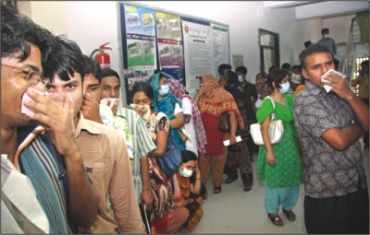
Current Scenario 1
Mohammad Kalam is a (fourth class )government employee. His elder son Babul is suffering from fever from 2 days.
As his income was little he took his son to Dhaka medical college hospital.
He bought a ticket and was sent to visit a doctor by the register. But the doctor was nowhere near to be found and the registrar couldn't tell when he should be available.

Slide 3
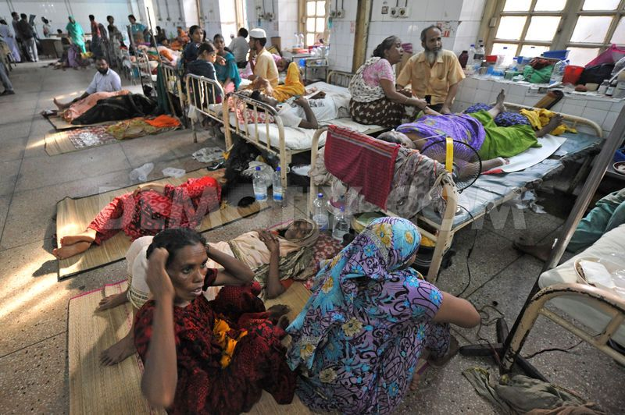
Current Scenario 1 (cont.)
So he waited 2 hours just to visit the doctor.
Then he was told to admit his son to the hospital but there he found that no bed was available.
But some broker offered him bed for money.
He admitted his son and went to get medicine but he found that the medicine was not in the store and he had to buy it.
He heard that the storekeeper sold them in the market for his own profit.

Slide 4
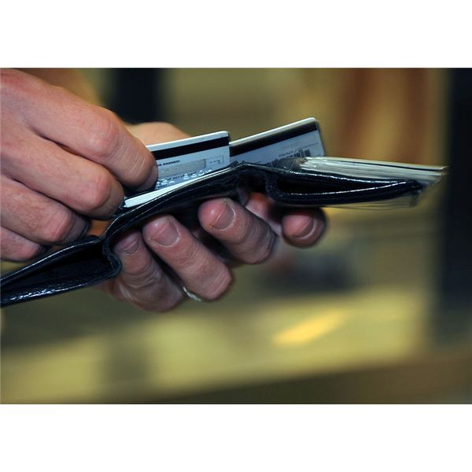
Current Scenario 2
Mrs. Halim is an old lady. She is not feeling well so she went to visit a doctor.
The doctor examined her and asked for her past history but Mrs. Halim lives in a different city and she didn't brought that.
So the doctor had to give her a lot of tests to diagnose her disease. In the end it was found that it was the continuation of a previous disease.
But those tests cost her a lot of money.

Slide 5
Existing Problems
In Existing public medical system, there occurs a lot of problems as well as wasting a lot of time. From those 2 scenarios we can easily identify some preliminary problems.
Manual registration system is a lengthy procedure → wastage of time and patience standing in long queue and crowd
Disordered and undeclared time schedule →patients are not concerned of doctor‘s availability.
Sometimes long human queue is not maintained properly.
Sometimes cunning brokers cheat people coming from far distance.
Some Private medical offers better service in huge costs→a nightmare for an ordinary people of our country.

Slide 6
Existing Problems cont.
Due to poor medicine distribution → patients face crisis severely in case of emergency treatment
For proper treatment doctors need past records of the patients .In most cases, patients just lost their medical reports , prescriptions ,how long they continued medicine etc.
Patients coming from far distance face difficulties much. Perfectly telling about intermediate medication becomes more hard.
Patients have to pay extra money for same medical reports they did before.

Slide 7
Existing Automated System
Patients are registered electrically only for the purpose of cost payments.
Money receipts for medicines are produced electrically. In some case, error prone software cause patients harassments about money

Slide 8
Our proposed System
We propose our system to remove existing deficiencies and provide some advanced service to all class of people.
Our first concept: A universal medical institution independent ‘Global Medication Database’.
Global database will not be under any hospital .Rather it contains all medical records of all patients across the country using national id card.
Once any patient is registered from any hospital across the country will be given medical services according to hospital.
Then the records will be saved in local hospital database and also be uploaded to Global Database for further better treatment
Records consist of electrically produced prescriptions , different medical reports(ecg,mri,ct scan,x-ray etc) and all the biological informations (blood grp etc.)of patients along with national ID No.

Slide 9
Our proposed System
Patients can be registered online or by sms from cell phone.
There will a store Medicine database .Where all kinds of medicine informations,usage,dosages will be recorded.
Doctors availability and schedule will be automated and updated in the hospital website.
All kinds of costs(medicine s,tests,services) will be produced electrically by our information system.Hospital can also issue credit cards.
For increasing much more consciousness about health and take immediate instructions from experts .There will be a doctor-patient forum or community .Also there can be forum developed for only doctors to share theirs knowledges.
Some system can be developed for employee management.

Slide 10
Benefits
Global Database provides all past records of patients .So next treatment will be much more better.
Automated system can reduce overhead problems of treatments.
Forum can develop more awareness or boost extra facilities.
Using medicine Database can reduce wrong treatments.
Hospital employees can be managed well.
A global blood record database can be developed and thus dying patients will be benefited.
A lot more benefits may be visible when implemented.

Slide 11
Any Question? Thank You

